Slide 2
Risk Assessments
A guide to
Risk Assessments

Slide 3
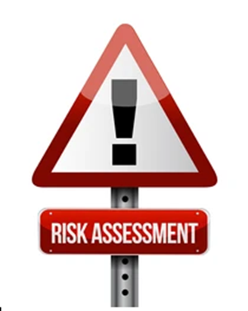
Risk Assessments
During the presentation we look at the following:
What is meant by risk assessment,
The 5 steps to a risk assessment,
A example of a church activity.

Slide 4
Risk Assessments
Risk Assessment
What is a Risk Assessment
A Risk Assessment is an examination of what in your environment or activities that take place there or elsewhere could cause people harm. You would then look at your options to ensure that you have enough precautions in place to prevent harm.
The aim is to make sure that nobody gets harmed or becomes ill.

Slide 5
5 Steps
The 5 steps to Risk Assessment
Identify the hazards
Decide who may be harmed and how
Evaluate the risks and decide on precaution
Record your findings and implement them
Review your risk assessment and update if required

Slide 6
Identify the Risks and Hazards
We need to look at and work out how people could be harmed. It is very easy to overlook hazards particularly when you work in the same place on a regular basis.
Let’s walk around the work place, examine our activities, and look at what could potentially cause harm.
Ask other people, they may have identified risks that you haven’t seen.
If using third party materials, make sure you check and follow the manufacturers instructions.
Have a look back at you accident book to see if that also identifies any potential hazards.

Slide 7
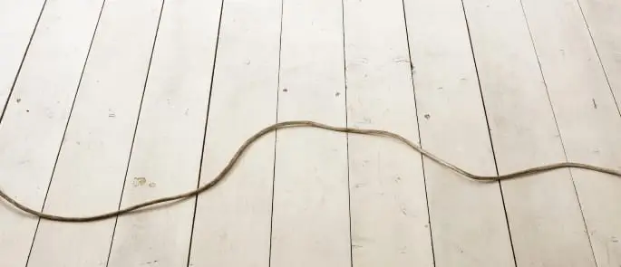
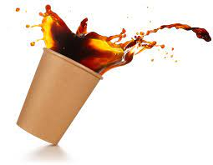
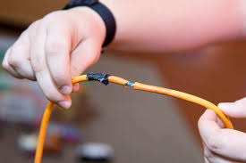
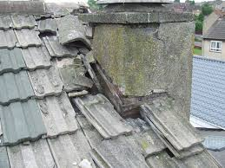
Types of Hazards

Slide 8
Decide who may be harmed and how
For each hazard that you identify you need to be clear about who may be harmed. It will assist you in managing that identified risk.
Remember to look at he dynamics of the people involved. Are they children, young people, vulnerable adults or do some of the attendees have any disabilities.
These groups of people could range from members of the public to cleaners, contractors etc.
If the location is being used by an external provider you will need to look at how it affects their activities. Talk to them, ask to see their risk assessment so you can compare both together to see if anything as been missed.
In each case, identify how they may be harmed and what type of injury or ill health may occur.

Slide 9
Evaluate the risks and decide on precaution
Having identified the risks you have to decide what to do to manage them.
Look at what your are doing at the moment and how you are managing that risk. If you need to do more then update the risk.
Always consider, can I get rid of the hazard, if not what can I put in place to minimise harm.
Provide welfare facilities such as First Aid and washing facilities.
Involve others who may be able to suggest risk management ideas.

Slide 10
Record your findings and implement them
Ensure that you review and update your risk assessment when necessary. This will ensure that everyone is as safe as possible.
Share the results with the necessary people such as PCC, Incumbent, PSO etc.
When recording include:
You made a detailed check
You identified who would be affected
How you dealt with the hazard
You minimised the risk
Who you involved in the process

Slide 11
Review your risk assessment and update if required
Review your risk assessment. Have you made any changes? Do you still need to make changes? Have you learnt anything from accidents or near misses.
Ensure that you update it when required and make sure you date it.
Don’t leave updating your risk assessment to the last minute. If anything changes update it then.

Slide 12
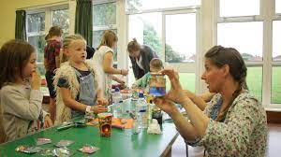
Lets look at an example
Messy Church

Slide 13
Where do we start?
Look at what the activity is,
Start to identify all potential hazards,
Get as much information as possible,
Start your risk assessment

Slide 14
What is the task?
What is the purpose of the task? Set a Messy Church for the children with various activities
What do we need to be looking at?
Set up of the hall prior to arriving. How do we do it? Who does it and what risks are associated i.e. moving and lifting chairs tables etc,
Are all staff safeguarding trained and DBSed where needed,
How do we record and manage who attends,
What activities are we providing. Arts and Crafts – what risks are associated to this i.e. use of scissors (possibly), use of paints etc,
Catering – Are food hygiene certificates in place, are we aware of food allergies. Make sure hot liquids are kept away from people. Use parents to supervise their children when eating,
Emergency and fire evacuation procedures on display,
First aid kits and first aid trained staff on site.
This list is not exhaustive and should be bespoke to your activities.

Slide 15
What do we do now?
Go through your risk assessment using the 5 step format discussed earlier on
When you identify a hazard, put a control measure in place to control it
If you feel the control measures put in place to manage the hazard are not sufficient, think about what other measures you will need to put in place to make it safer. Ensure that you document these and date them.

Slide 16
Further information
Further information can be found within the Safer Activities area on the Diocese of Hereford Safeguarding pages. Here you will find many useful documents and templates to help you risk assess activities.
Please click on the link below
Link here once page is created

